Slide 1
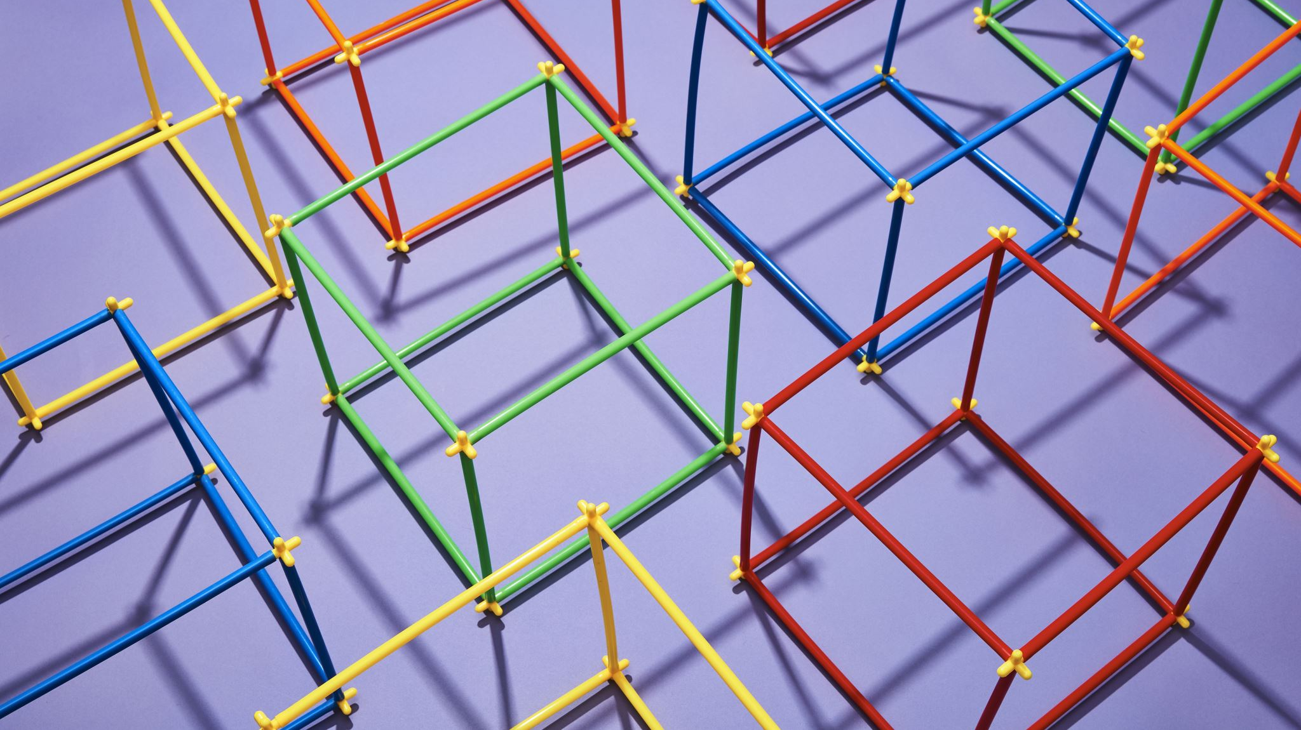
Computer Architecture
The implications of computer architecture models and the impact of the relationships between their component parts.

Slide 2
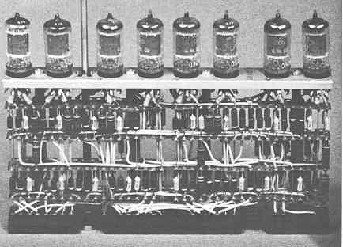
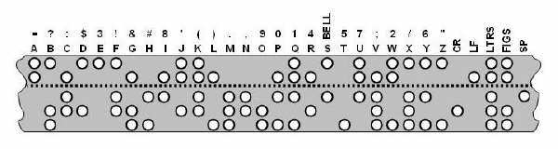
The Stored Program Concept
A little bit of history
A program must be resident in main memory to be executed. Machine code instructions are fetched from main memory one-at-a-time, decoded and executed in the processor.
The first computers did not use the stored program model, as programs were hard coded by setting switches. A technician needed to flip switches each time a new program was needed. Later system used punched tape to hold the programs and data.
Modern computers have superseded these as electronic memory is used instead.

Slide 3
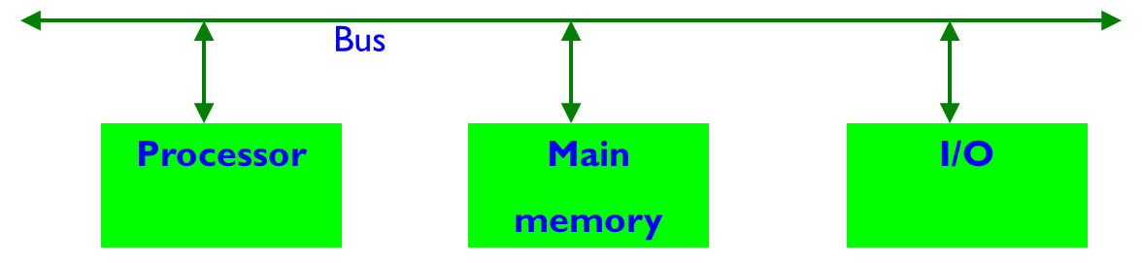
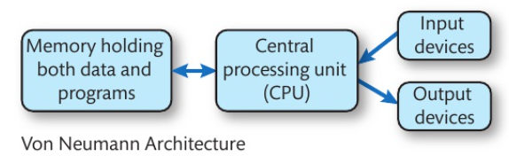
Von Neumann Architecture (Older)
It is named after the mathematician and early computer scientist John Von Neumann.
The computer has single storage system(memory) for storing data as well as program to be executed. Von Neumann machines have shared signals and memory for code and data
Processor needs two clock cycles to complete an instruction.
In the first clock cycle the processor gets the instruction/address from memory and decodes it. In the next clock cycle the required data is taken from memory. For each instruction this cycle repeats and hence needs two cycles to complete an instruction.
It is like reading the 'Address' on an envelope and then opening it up to read the actual 'Letter' inside.

Slide 4
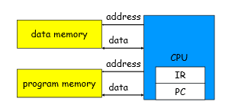
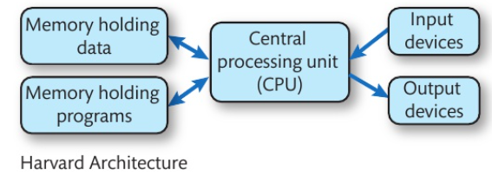
Harvard Architecture (modern)
The name is originated from "Harvard Mark I" a relay based old computer.
The computer has two separate memories for storing data and program.
It has physically separate signals and storage for code and data memory. It is possible to access program memory and data memory simultaneously. The processor can complete an instruction in one cycle.
In the first stage the instruction/address to be executed can be taken from program memory. In the second stage data is taken from the data memory using the decoded instruction or address.
Each cycle, CPU takes data from registers, does an operation, and puts the result back
It is like reading the 'Address' on an 'opened' email and read the actual 'Email' content inside at the same time.

Slide 5
von Neumann vs. Harvard
von Neumann
Same memory holds data, instructions.
A single set of address/data buses between CPU and memory
Harvard
Separate memories for data and instructions.
Two sets of address/data buses between CPU and memory
Harvard allows two simultaneous memory fetches.

Slide 6
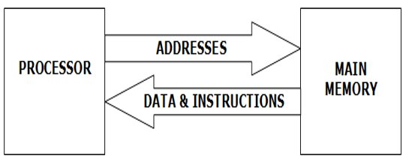
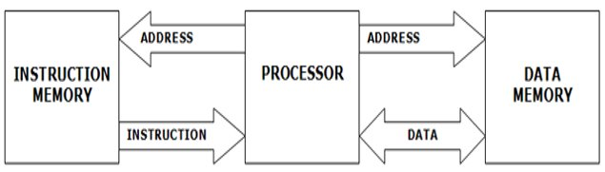
The Stored Program Concept
A program must be resident in main memory to be executed. Machine code instructions are fetched from main memory one-at-a-time, decoded and executed in the processor.
Von Neumann Architecture
In a von Neumann machine, a single store holds both instructions and the data that they are carried out on.
Harvard Architecture
A Harvard machine has a separate store for data and instructions. In the von Neumann machine, data and instructions share the same storage space and are fetched along the same bus. In the Harvard machine, throughput is quicker since there are separate stores for data and instructions and separate buses to connect them to the processor.

Slide 7
Mixture
Modern CPUs use Harvard architecture inside the chip to separate the code and data into threads for faster processing, but the connection of the CPU to the Motherboard and components will be Von Neumann
Cluster Computers
Supercomputers used by the met office use the cluster computer architecture, which have 100's or 1000s of CPU's carrying out Trillions of calculations. Home PC's can also be used in this way to boost processing power.

Slide 8
UMA and NUMA
Uniformed Access Memory – sharing the RAM between Mutiple processors and having the ability to access any part of the Memory. The same memory bus is use by both CPUs and can have their own shared cache memory allocated in the RAM.
Non-Uniformed Access Memory – an alternative technique to share RAM whereby each CPU can have some RAM Memory allocated as local memory as well as share other parts with the other CPU.

Slide 9
Apple on Windows? (EMULATION)
Processors are designed in families (8086 (intel) or 8088 (IBM)) and use Low Level program (binary replaced by mnemonics) commands.
Apps use an API (Application Program Interface) to instruct or send requests to the OS to get the hardware to do something. They will not usually run on an OS from a different family.
This is where Emulation occurs as it will allow a software program to run on another processor family allowing an OS to run a program designed for another processor.

Slide 10
Factors affecting the choice of different architecture models
Suitability of a computer architecture model is a complex mixture of the user experience, the apps currently available for the architecture and how well the platform integrates with other systems run by an organisation.
Cost of ownership is calculated from the initial cost plus the ongoing expenses, which includes any licenses that require regular payment, and support cost.
Von Neumann with UMA – default choice for modern single user running one or more apps
Hardvard – default for small dedicated devices as code burnt on to ROM and a separate RAM used for change but small instruction/data.
Cluster computing with NUMA – goo for big data processing where data coming in for multiple sources.
UMA – Where a computer has 2 processors on a motherboard (networked server computer).

Slide 11
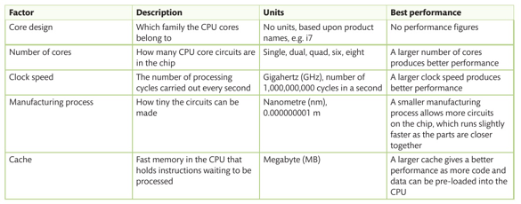
CPU Performance Factors

Slide 12
Activity – Chop and Change
Going through the pdf file (LA B – Computer Architecture) provided edit the above slides either by adding to or replacing information.
Add to the PowerPoint; the next 2 slides have a list of features which need to be expanded on.

Slide 13
Concepts of Microarchitecture
Instruction cycles.
Execution speeds:
o factors affecting execution speeds
o methods of increasing execution speed
o implications of execution speeds.
Pipelining.
Cache.
Registers.
Multi-processing and multi-threading.
What am I?
How do I work?
What's the Impact?
Pictures, pictures and more pic's

Slide 14
Registers and Register Handling
Types of register:
o general purpose register
o special registers:
– accumulator
– instruction register
– memory address register (MAR)
– memory data register (MDR)
– program counter.
The function and purpose of general and special registers and their impact on the way computer systems perform.
The role of interrupts in a computer system.
What am I?
How do I work?
What's the Impact?
Pictures, pictures and more pic's

